Slide 1
Welcome to the Coalition Kickoff for 2022-23
Notes:
Margaret & Diamond

Slide 2
Agenda
Welcome & Introductions - AnaVivian Estrella, Norwalk Human Services
Prevention 101 - Margaret Watt, TNP Co-Chair- Positive Directions
Focus on Upcoming Collaborations - Denique Weidema-Lewis, Norwalk ACTS
Marijuana
Resource Sharing & Networking
Notes:
Margaret & Diamond

Slide 3
About TNP
Coalition of community members and organizations dedicated to preventing substance misuse and promoting mental wellness among Norwalk youth & young adults
State-designated Local Prevention Council (LPC)
Leadership team includes City (AnaVivian Estrella), Schools (Jim Martinez and Tory Sullivan), Norwalk ACTS Collective Impact group (Denique Weidema-Lewis), Behavioral Health Agencies (Courage to Speak, Human Services Council, Positive Directions)
Please subscribe to thenorwalkpartnership.org!
Like & follow us on Facebook and Instagram - and RESHARE!
Notes:
Diamond

Slide 4
Introductions
In 30 seconds or less…
Please share your name, pronouns (if comfortable), organization &/or stakeholder group(s) you represent
Answer: Are you an early riser or late owl?
Notes:
Ana

Slide 5
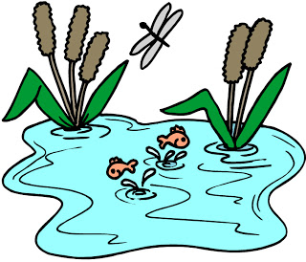
Prevention 101
Prevention work seeks to affect individuals in the context of their local community and its broader environment
Individual, Community, Environment
Notes:
Margaret
Fish in a dirty pond, covered in sludge, fins can’t move, drowning.
Individual approach: Take it out and clean its scales off and put it back.
Community approach: Add water purifier tablets.
Environmental approach: Clean upstream!
This relates to
Fish = individual residents
Water = school/job, home, houses of worship, extracurriculars, neighborhood
Environment = Westport culture, institutions, laws, enforcement
All these groups need to be around the table b/c they each have a different experience, perspective, and impact. They can each inform on what is happening, what might work, what the needs are. And there are some things that cannot be done with one group only!

Slide 6
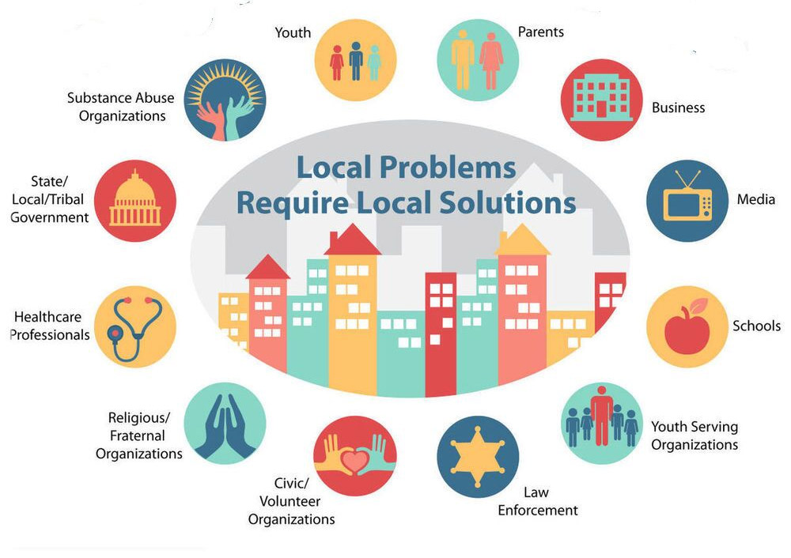
Prevention work is…
planned and carried out by a community coalition
Notes:
Community coalition: basically volunteers! The idea is that people are experts in their own corner of their community–even if they don’t have a public health background or know a lot about behavioral health.
All these groups need to be around the table b/c they each have a different experience, perspective, and impact. They can each inform on what is happening, what might work, what the needs are. And there are some things that cannot be done with one group only! As we begin this new year and look at the sectors represented around the table, please think about any that may be missing and feel empowered to share this work with anyone who you may know in those missing sectors. (Do we want to add an early call to recruit?)

Slide 7
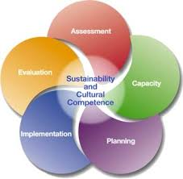
Prevention work is…
informed by the Strategic Prevention Framework (SPF)
Notes:
importance of capacity
assessment

Slide 8
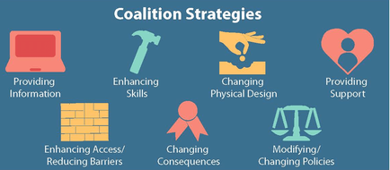
Prevention work is…
built on 7 strategies for change (individual and environmental)
Notes:
How do we get to that point?
So what does a coalition do to create change?
Individual vs environmental strategies
-Which strategies are most effective for an individual person?
-Which are most effective on the community level?
Which require the greatest effort to be implemented?
Let’s look at examples of what’s been done here in Westport related to each strategy. Let’s use vaping as the example.
Who was providing information about vaping over the last couple of years in the community? To whom?
Who was building kids’ skills? Parents’?
Who was changing the physical design (e.g., packaging)?
Providing support (eg cessation)?
Changing access (eg smoke detectors)?
Changing consequences (citations, OSS vs ISS vs JRB referral)?
Which sectors did those things: parents? Schools? Nonprofits?
Our coalition should have those people at the table. And our coalition can work to address the areas no one else is. 🡪 PLAN
1 strategy isn’t enough to create real change. For example, if we want to reduce or stop people from vaping marijuana, is it enough to provide support groups for people who are using it?
When a coalition is small, there’s only capacity to do a few individual programs, but not to have a comprehensive strategy. That’s why this year our LPC grant from the state includes a focus on building the coalition and its capacity so that we’ll be better positioned to do more in future. It also includes a focus on vaping.

Slide 9
Prevention work is…
Important to sustain! Requires coordination of volunteers/sectors
Underfunded! TNP has $155K/year at present; Courage to Speak has varied funding to work around the state/US
CDC Drug-Free Community grant (managed by Positive Directions) - $125K/year for 5 years, renewable once
DMHAS LPC grant (managed by HSC) - <$9K/year
DMHAS SOR grant - $5K/year
City grant (managed by HSC) - traditionally $16K
Volunteerism equals another $150K!

Slide 10
Sustainability?!
Use of funds
Staff time to do outreach, education, coordination, provide data, present data, run community events (eg Backpack Drive, Family Day, NorWALK for Mental Health), run student clubs & groups
Conduct survey: $9000 for 2022
Mail one postcard to MS and HS families: $1500
$$$ ???

Slide 11
Big Initiatives This Year
2022 Norwalk Youth Survey - October
Freshman Forum - November
Data presentations - January
Johnny’s Ambassadors marijuana prevention education
Teen Nights Out
NorWALK for Mental Health
Awareness Campaigns (signage, billboards, postcards)
Norwalk Strong youth clubs
Environmental scan
Sustainability planning
Notes:
Denique

Slide 12
4 Things to Know
about the Youth Survey
Our Youth Survey has brought new resources to our schools and community: Drug-Free Communities grant, social workers in schools, LGBTQ training, teen support groups
We will gather data on mental health, stress, suicide, substance use (including access, age at first use), bullying, social media, gaming, extracurriculars, trusted adults, connectednes to others.
It is anonymous and confidential. Parents and kids can opt out.
This information is intended to be used by ALL of us! It will serve the City, schools, nonprofits, families.

Slide 13
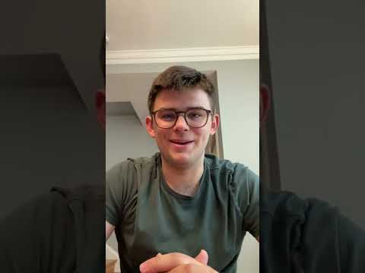
Freshman Forum
For 9th graders AND parents - raise awareness / provide messaging and resources related to mental health and substance misuse
Will involve a prevention & wellness fair
At both HS buildings in November (no dates yet!)
Sign up at TNP table
Notes:
show Jordan’s video (6 min)

Slide 14
Marijuana
For 9th graders AND parents - raise awareness / provide messaging and resources related to mental health and substance misuse
Will involve a prevention & wellness fair
At both HS buildings in November (no dates yet!)
https://youtube.com/shorts/WDLjzeNdjTI?feature=share
Notes:
Margaret & Diamond lead discussion - notes on flipcharts

Slide 15
Networking & Resource Sharing
Please have a snack to munch on while you visit the info tables, pick up resources and find out what others in Norwalk are offering!

