Slide 1

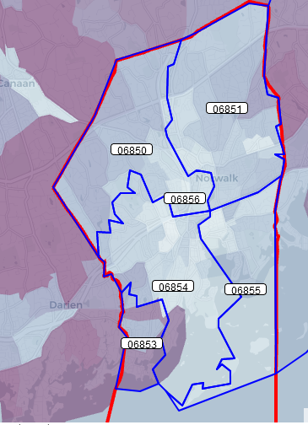
Community Survey Results
Responses by zip code:
37%
20%
292 surveys collected from Norwalk adults via Survey Monkey,
December 2020 to March 2021
20%
7%
17%
Notes:
3 versions available via Survey Monkey link.
273 in English (93.5%)
18 in Spanish (6.2%)
1 in Creole (.3%)

Slide 2
We will cover:
Demographics of respondents
Impact of COVID on wellbeing (including awareness of resources)
Substance use norms
Reported training needs
Notes:
This is one aspect of our data collection. Also did focus groups in the fall and are about to conduct a survey in schools.

Slide 3
How do you identify?
(multiple responses allowed)
  Bisexual - 4%
  Gay/Lesbian - 5%
  Queer - 3%
  Straight/Heterosexual - 84%
  Transgender - 1%
  Prefer not to respond - 6%
Demographics of Respondents
(Age, Gender, Language)
Notes:
3 versions available via Survey Monkey link.
273 in English (93.5%)
18 in Spanish (6.2%)
1 in Creole (.3%)
88% primary language English, 11% Spanish, 1% Creole
Biggest age group of respondents 18-34 (46%) and 35-55 (36%)
Similar rates between males (50%) and females (48%) (unusual)
Race: American Indian/Alaskan Native – 2.2%
Native Hawaiian/Pacific Islander .7%

Slide 4
Demographics of Respondents
(Race & ethnicity)
Notes:
Muliple responses were allowed for Race question
American Indian/Alaskan Native – 2.2%
Native Hawaiian/Pacific Islander .7%
Norwalk 2019 CERC town profile
For 2013-2017
White non-Hispanic – 52%
Black non-Hispanic – 14%
Asian (5%)
Hispanic – 27%

Slide 5
Impact of COVID on Wellbeing
Think about…
Where do you expect Norwalkers to report the largest negative impact? Emotional wellbeing, relationships, physical health, or finances?
Do you expect Norwalkers to report increased or decreased access to services? Healthcare, mental health supports, food, transportation?

Slide 6
COVID has had the largest negative impact on Norwalkers’ emotional wellbeing
Notes:
Note that 42% to 53% of people report no change and there is also a decent sized population that is doing better on each aspect
In what ways has COVID19 affected the following? Your…
Respondents are most impacted in terms of their emotional wellbeing (4 out of 10 respondents)
Also 1 in 3 report their financial security is ‘worse’ now.
When looking at relationships – the same % are reporting worse and better
Physical health – just over ¼ worse and just under ¼ better
So the next slide show reports on ACCESS to health care and mental health supports during COVID (along with food and transportation) and not surprisingly…

Slide 7
Norwalkers report less access to healthcare and mental health supports due to COVID
Access to:
Notes:
Great negative impact is reported around access to health care (31% worse) and mental health supports (22%)

Slide 8
Similar percentages of Norwalkers have increased or decreased their substance use during COVID
Notes:
In what ways has the COVID19 pandemic affected you in terms of the following behaviors:
Not included – Do not use/not applicable
We also asked about the impact of COVID on substance use – for those who reported any use – the largest change (Both in terms of increase and decrease) is seen in alcohol use.
But should also note that 10% of all respondents have increased their use in nicotine, marijuana and prescription drugs FOR THE PURPOSE OF GETTING HIGH OR TO FEEL GOOD.

Slide 9
6 out of 10 Norwalkers are experiencing Psychological Distress
On the PHQ-4 (embedded in our survey):
62% of Norwalkers scored as having for Psychological Distress
29% are at risk for moderate or severe anxiety & depression
Notes:
An ultra-brief screening scale for anxiety and depression: the PHQ-4
Not at all = 0, Several Days = 1, Nearly every day = 2, More than half = 3
ScoringPHQ-4 total score ranges from 0 to 12, with categories of psychological distress being:
•None0-2
•Mild3-5
•Moderate6-8
•Severe9-12
Depression Subscale:
Little interest or pleasure in doing things
Feeling down, depressed, or hopeless
Anxiety Subscale:
Feeling nervous, anxious or on edge
Not being able to stop of control worrying
The PHQ scales were developed by Drs. Robert L. Spitzer, Janet B.W. Williams, and Kurt Kroenke and colleagues.
The PHQ scales are free to use.

Slide 10
Parent respondents are concerned about their children’s mental health and wellbeing
How concerned are you about your child’s current level of:
Notes:
Not only
2nd half of survey was for parents of MS and HS students only –
102 total respondents (1 did not complete the ‘oldest child’ question)
Range was:
not at all concerned
Slightly concerned
Very concerned
Extremely concerned
Academic achievement COMPARED TO LAST YEAR

Slide 11
Experiences & observations on mental health & impact of COVID
Sample community comments:
“I often feel nervous and can’t relax”
“Anxiety has gotten worse since the beginning of pandemic”
“The effects of the pandemic on the youth adult population is underestimated. The phrase ‘Kids are resilient’ is overused…”
“I do pastoral care check ins with the elderly and many homebound people. Seems like increase in depression for those that are alone or having difficulty not being able to go out or socialize due to COVID…”
Sample parent comments:
“Watch your child’s behavior”
“Pay more attention to your child’s movement”
“Providing more meaningful community services for minors”
“The oxygen mask is real. All the work I put into my own well-being has been reflected in the well-being on my family members….”
Notes:
Themes:
Increased anxiety (1 related to income decrease)
Impact of covid affects so many areas of life (underreported)
Big concern for people who live alone or isolated
1 comment - more people are willing to talk about mental health

Slide 12
Discussion around covid & wellbeing findings
Questions?
Comments?

Slide 13
Resources & supports participants are aware of:
All respondents:
Parent respondents:
Notes:
Which of the following services are you aware of that connect people in need to available resources? (n=289)
Which of the following free supports & resources for Norwalk youth are you aware of? (n=88)

Slide 14
Substance Use Norms
Think about…
How much do you expect Norwalkers to report alcohol & drug use as a normal part of growing up?
Do you think Norwalk parents believe they can affect their children’s substance use?
How do you think reported ease of access may have changed during COVID?

Slide 15
Norwalk Community Norms around Substance Use
What % of Norwalkers believe that alcohol & other drug use are a normal part of growing up?
Alcohol: 28%
Marijuana: 16%
How common / visible is substance use?
Alcohol is common at beaches (43%) and school grounds (23%)
Weed is commonly used at home (30%)
It’s ok to use marijuana (25%)
Vaping is socially acceptable: 25%

Slide 16
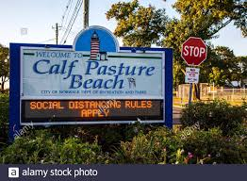
Community norms around alcohol: Just over 1 in 4 respondents believe drinking alcohol is a normal part of growing up.
Notes:
Strongly disagree, disagree, neither agree or disagree, agree, strongly agree
Please choose the response that best describes how you feel: n=270
Alcohol consumption is common at our local beaches.
Alcohol consumption is common on school grounds when families are attending sports games or band concerts.
Drinking alcohol is a normal part of growing up.
It is easy to find substance-free social activities in our community.

Slide 17
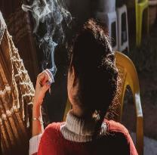
Fewer respondents feel that using marijuana is ‘a normal part of growing up’…
Notes:
Strongly disagree, disagree, neither agree or disagree, agree, strongly agree
Please choose the response that best describes how you feel: n=270
In our community, marijuana (weed, THC) is commonly used in homes.
Using marijuana (weed, THC) is a normal part of growing up.
It is okay to use marijuana recreationally.
Vaping nicotine (e-cigarettes, JUUL, Puff Bars, Blue, etc.) is socially acceptable.
Vaping nicotine is safer than smoking cigarettes.

Slide 18
Most parents who took this survey are talking to their children and taking appropriate steps around substance use.
Parents who report ‘some or most’ of the time they…
Talk to their child about the dangers of substance use – 70%
Take steps to ensure the kids are not drinking in their home – 66%
Take steps to ensure the kids don’t use marijuana in their home – 78%
Lock up prescription medications in their home – 58%
Notes:
Parents! – communication & limiting access

Slide 19
1 in 4 parent respondents feel they have little control over whether their teen drinks or uses marijuana.
Notes:
FAMILY NORMS – discuss impact
Strongly disagree, disagree, neither agree or disagree, agree, strongly agree
Please choose the response that best describes how you feel:
n=102
I have very little control over whether my teen drinks alcohol.
I have very little control over whether my teen uses marijuana (weed, cannabis, edibles, THC).
I think teenagers should be allowed to drink during high school, so they learn how to drink responsibly.
I prefer that my child drink at our house to avoid driving under the influence.
I teach my child not to drink until they are 21 or older.
I teach my child that marijuana is an illegal drug.

Slide 20
Alcohol from HOMES is perceived to be the ‘easiest’ substance for teens to get.
Notes:
How does this relate to what youth are saying about access to substances?

Slide 21
Norwalk youth discuss substance use rates and ease of access:
Alcohol
Marijuana
Vaping
  Most youth said use has remained the same or increased & that alcohol is easy to get
    1 teen felt that alcohol use was happening more among adults versus teens to cope with what was going on
    Her classmates “are doing things they shouldn’t be because they have nothing better to do and a lot of them have stress and stuff also.”
  Most youth said use has increased & that marijuana is easy to get
    One male was not sure if increase was due to increased stress or being inside
    Another male thought increase was because of free time among peers
    “overly easy” to get
    One female stated that she could “get it from 5 different people right now” if she wanted to get it.
  Most youth said use has decreased or remained the same & vapes are easy to get
    “the hype around vaping has gone down; only people with nicotine addiction still do that”
    One female said her friends have switched to vapes because they don’t have the money for marijuana
Notes:
October 19th 2 virtual focus groups at Brien McMahon HS – during Health class.
All juniors and seniors. 22 students in total.
ALCOHOL:
Ease of Access
Majority of youth felt it was Easy to get access to alcohol
2 students who indicated it would be hard stated that they would never take it from their home.
Where is access from?
Older siblings/friends (3)
Parents' stash/homes (4)
Stores (3)
MARIJUANA:
Where is access from?
Social media – Snapchat
Plugs
School
Friends
Parents – one female said she know about parents who give their child permission to use marijuana
VAPING
Where is access from?
Stores (some places don’t card)
Gas stations (not checking IDs) “my friend can just go buy at a gas station and is not carded”
Students selling to students (in school too)
Friends

Slide 22
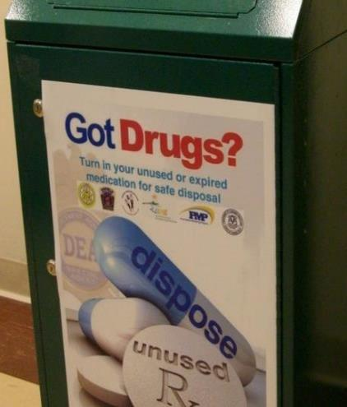
Respondents are aware of Social Host Law, Tobacco 21 & proper prescription drug disposal.
How familiar are you with…
2017, n=152; 2020, n=111 Very or Somewhat familiar
Notes:
the Connecticut law that took effect in October 2019 raising the age to 21 to purchase tobacco and vaping products? (unfamiliar 29%)
the state’s Social Host Law that makes it illegal to provide a place for teens to drink? (unfamiliar 36%)
proper ways to dispose of unused, or excess prescription drugs that are in your home? (Unfamiliar 22%)
proper ways to safely store prescription medications in your home? (unfamiliar 23%)

Slide 23
Sample experiences & observations around substance use
“A few days ago, I saw my neighbor's daughters sitting with her drinking beer and smoking marijuana with her. First it made me sad and then worries because she said, "do you see how big my girls are getting" and they're between 12 and 15. It's really worrisome that many parents support this type of vice.”
“Strengthen the supervision of minors’ drinking”
“You can’t take drugs. It’s bad for you and your family.”
“…many families drink socially and the teenagers either take the liquor from their parents, and if they know friends who are just older than 21 they pay them to make the purchase for the minors.”
“I see more substance abuse in our area and more fights.”
“FYI marijuana is legal for certain conditions and I have my card. My children know that I use it for a health condition and are aware that it is illegal unless prescribed.”
Notes:
Several comments on
Not using drugs, bad for health, harmful, endangers others.
More supervision needed
Importance of communication with kids
Importance of supervision
Observation
Pay attention to what is going on with your kids.

Slide 24
Discussion around Community norms related to substance use
Questions?
Comments? How does this affect our work?

Slide 25
Information & Training Interests
What information or training are you most interested in to support your child’s health & wellbeing? (Parents only)
  26% Recognizing/responding to a mental health crisis
  29% The new marijuana
  30% Social emotional learning
  31% Risks of vaping
  31% Power of Parenting
  34% Is my child using drugs?
  36% Communicating with teens
  37% Stress management
  44% Risks of underage drinking
Notes:
Also asked parents “which of the following would be best for you if you wanted to attend a training or presentation?
Resource table - 25%
Short video access on the web, different topics – 36%
Online event, school night – 43%
Live, socially distant event – 50%
Recorded presentation, at time of my choosing – 56%

Slide 26
Next Steps
Questions? ninachanana@gmail.com
Who else needs to see this information?
How should it be presented?

