Slide 1
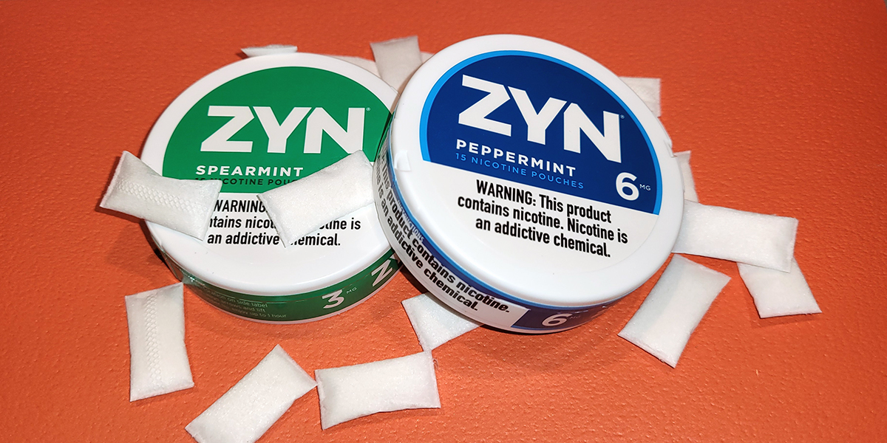
Emerging Trends
Nicotine Pouches
Notes:
NICOTINE POUCHES
Brought to our attention via The Hub (region 1 RBHAO).
Zyn nicotine pouches which are derived from tobacco and contains nicotine but no tobacco leaf (like a chewing tobacco does). Oral nicotine pouches and lozenges are a new category of tobacco product that includes brands such as Zyn, On! And Velo – and they come in many flavors (which appeals to youth). Sales increased 470% in 2020. and Truth Initiative shows 13% of 15-24 yo’s using in past month.

Slide 2
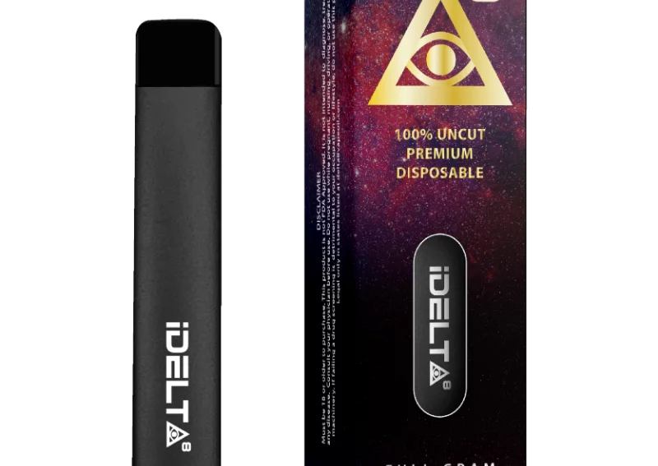
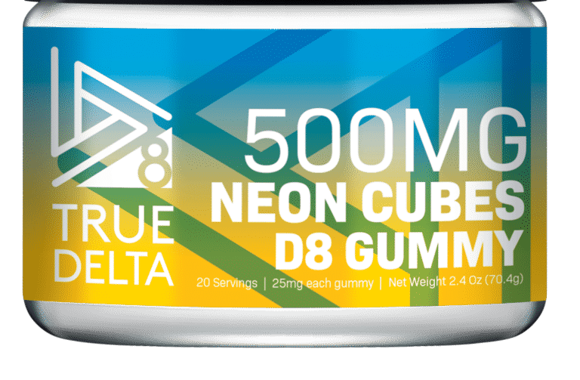
Cannabinoids
Notes:
Delta-8 is a naturally occurring chemical compound called a cannabinoid that’s found in small traces in hemp and cannabis (marijuana) plants. Its popularity is on the rise, and you can find it everywhere from dispensaries to convenience stores.
How Does It Compare to Regular Marijuana or Delta-9-THC)?
Delta 8 has a similar chemical structure to Delta-9 and both are forms of THC. But when people refer to THC, they usually mean the Delta-9 that’s found in high concentrations in marijuana. Both produce a euphoric, fuzzy feeling, but Delta-8 causes a milder high. (also will see Delta-0 THC, Delta-10 THC
HHC? (image on the right)
a hemp-derived cannabinoid that is apparently popular in affluent communities, according to a Peer Support Specialist- Ally. Some young people she works with who are at private schools / live in affluent neighborhoods like it because they think it's not detectable on drug tests. It's expensive so apparently the urban kids say they would rather just go to the bodega for delta 8.
How is HHC different from THC or delta-8?
Chemically speaking, HHC includes a hydrogen molecule that THC does not.
Consumers and scientists alike observe that HHC induces less potent and psychoactive effects than conventional delta-9 THC.
Manufacturers often equate the HHC high with a delta-8 THC high.
Among all of the hemp-derived cannabinoids being sold —delta 8 THC, delta-O THC, and delta-10 THC among them—few have eluded public understanding more than HHC. Googling the compound brings up a host of contradictory information: about its legality, its effects on the body, and even whether it occurs naturally in the cannabis plant.
Read about it: https://www.leafly.com/news/strains-products/what-is-hhc
She also shared a youtube video called HHC Carts: Watch This Before You Buy from a channel called the Strain Show.

Slide 3
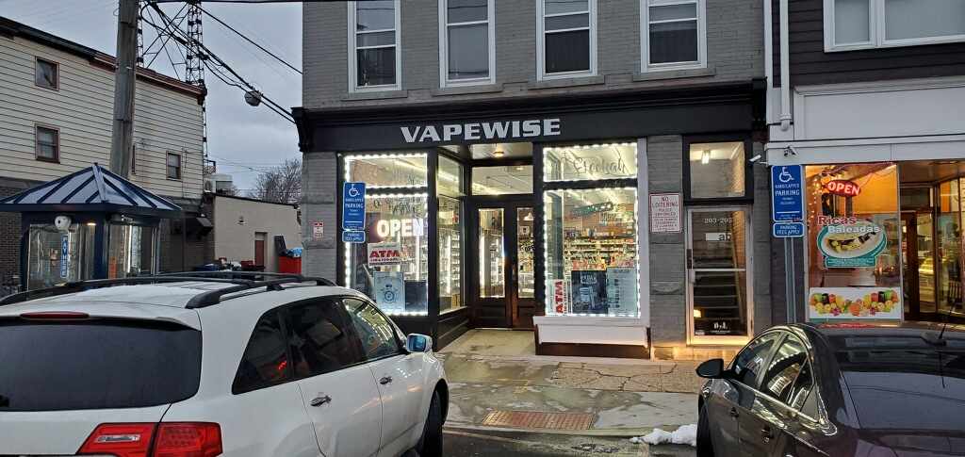
Fined 8 times
Offered Delta 9 to TNP members
Notes:
As CT and federal agencies continue to ban delta-8 THC, the most popular hemp-derived cannabinoid, HHC offers a tiny bit more legal promise—and appeal—since it’s not actually a THC compound at all. It may also elude drug tests, although the evidence for that is purely anecdotal at this point.
“HHC is one of our fastest growing products,” Liam Burns, founder and CEO of Bearly Legal Hemp, one of the main retailers of the cannabinoid, told Leafly. “That’s due to regulations that have banned Delta-8, but people are buying it in states where they can buy Delta-8, too.”

Slide 4
Notes:
August 2022 -
The US Drug Enforcement Administration issued a warning about “brightly-colored fentanyl used to target young Americans.”
Law enforcement seized colored fentanyl and fentanyl pills in 18 states in August.
“This trend appears to be a new method used by drug cartels to sell highly addictive and potentially deadly fentanyl made to look like candy to children and young people,” the DEA said.

