Slide 1
2024 TNP Annual Meeting
Welcome! As you arrive, please pick up resources, sign your Coalition Involvement Agreement, & enjoy refreshments!
Today’s Agenda:
Welcome
Panel Discussion: Illegal Sales at Smoke Shops
Recognition Ceremony

Slide 2
About The Norwalk Partnership
We are a coalition involving the City, Schools, Nonprofits, Businesses, Parents, Teens & other stakeholders working together to prevent substance misuse and promote mental wellness in Norwalk youth & young adults.
We conduct surveys, develop initiatives, provide training, create supports & resources, sponsor the Norwalk Strong clubs & more! Join us!
Please visit thenorwalkpartnership.org for info & resources
Follow us on Facebook & Instagram @thenorwalkpartnership
Notes:
Introduce self - mention PD & HSC as funders - all tonight’s presenters are part of TNP
Mention our survey, liquor stickers, teen nights out, teaching kids in schools, parent & teacher trainings coming up, resources on website … Norwalk Strong clubs

Slide 3
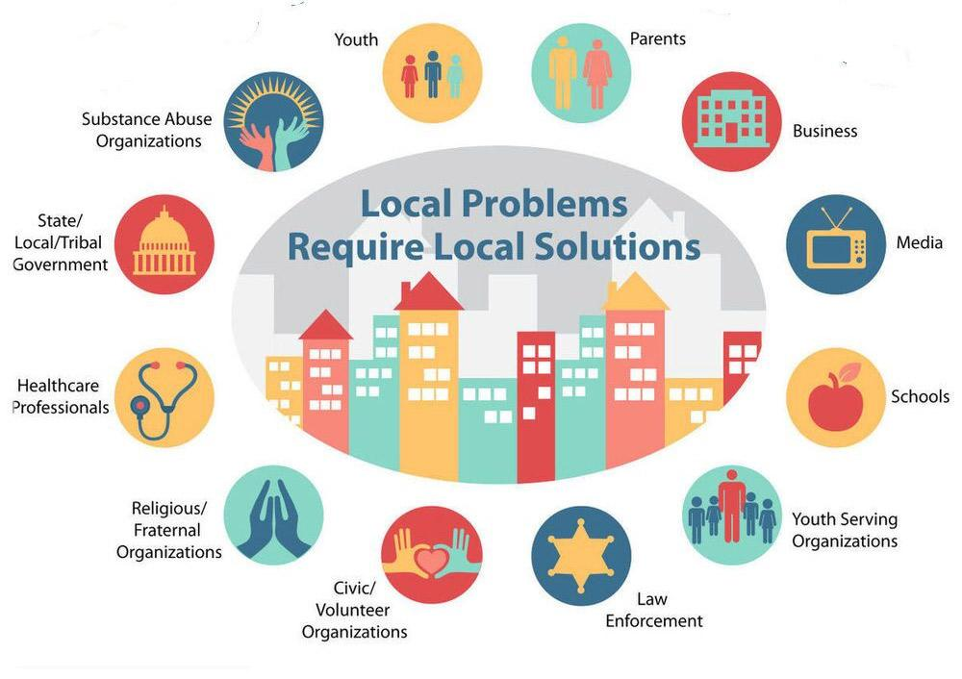
How we work
State-designated community prevention coalition
12 required sectors and 30+ community agencies as partners
Funded through CDC Drug-Free Communities grant, the LPC and SOR mini-grants from DMHAS, and the City of Norwalk
Work based on youth survey findings & the 7 strategies for community prevention
Notes:
DFC = drug-free communities (federal grant)
LPC= local prevention council (state grant)
Of the $134K, $125 is DFC funding. State only provides around $9K to Norwalk.
The $60K includes $20K for the PD-YBI support groups and $40K for Teen Nights Out

Slide 4
Illegal Sales from Smoke Shops: What can we do?
A panel discussion with:
Denique Weidema-Lewis, Behavioral Health Program Manager, Prevention & Health Promotion, DMHAS
Daniela Montes-Hawley, Lead Special Investigator, Prevention & Health Promotion Division, DMHAS
Ralph Blessing & Vineeta Mathur, Stamford Zoning & Ingrid Gillespie, Liberation Programs / Stamford local prevention council
Steve Kleppin, Director, Norwalk Planning & Zoning
Lt. Tomasz Podgorski, Community Services Division, Norwalk Police Department

Slide 5
Recognition Ceremony

Slide 6
2024 Recognitions
Advocacy Award: Lamond Daniels, Chief of Community Services
Sector of the Year: Norwalk Police Department (presented to Lt. Podgorski)
Community Partner of the Year: Family & Children’s Agency (presented to Jessica Vivenzio)
Youth Leader Award: Dyan Sommerville
Youth Leader Award: Jake Tejada
Youth Leader Award: Anthony Certo
And thanks to all of YOU for your role in keeping our youth healthy & safe!

Slide 7
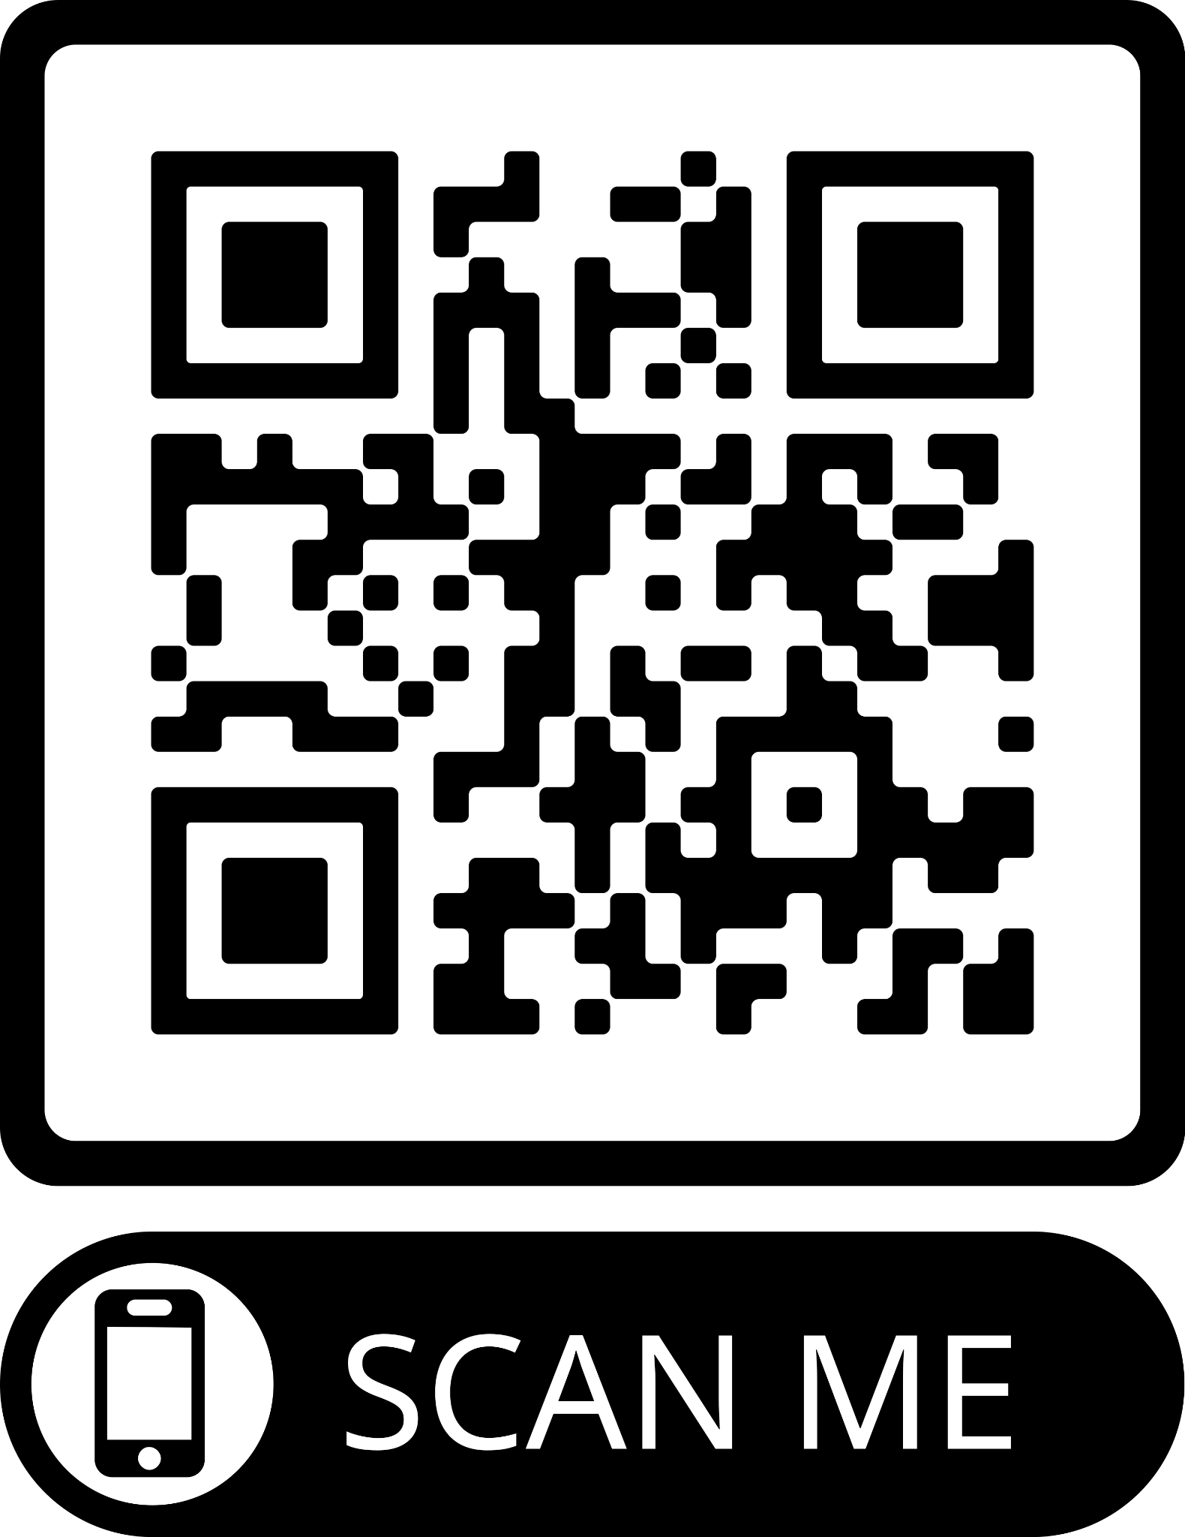
In closing…
Please complete our member survey!
https://www.surveymonkey.com/r/TNPMemberSurvey2024

