Slide 1
TNP Coalition Meeting
March 2024
Norwalk Public Library

Slide 2
Meeting Agenda
Welcome! Please visit the resource table to sign up to distribute lawn signs and pick up resources!
Introductions of New Members
Coalition Activities
Highlights of past month
Cannabis Support
Alcohol Awareness Support
May Walk + Wellness Fair
Video Project Sign-Up
Social-Emotional Health / Day of Training
Data presentation: Norwalk ED Visits for Mental Health & Substance Use - by Brian Weeks, Norwalk Health Dept
Please help yourself to a snack, share your resources & fill out the sign-ups when you arrive.
Notes:
Cadence - 1-2 min
New member to intro herself is Hiba Nbou, our new Prevention Corps member
Coalition activities will be 10-15 minutes, 3 minutes on Day of Training, and the rest of the time for the data presentaiton

Slide 3
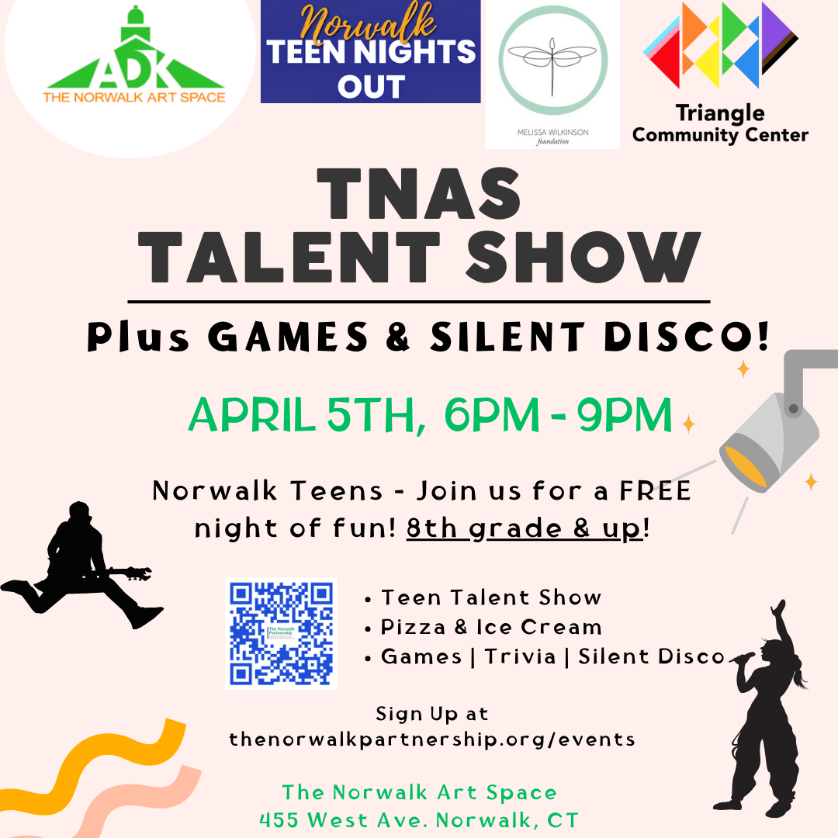
Coalition Highlights of Past Month
Organized Wellness Fair at NHS/PTECH - 14 provider & 4 student tables
Updated our resource videos for teens
Teens had awareness tables at both HS
FCA organized Virtual Conversation on parenting incl. Mid-Fairfield & Pos Dir
Marijuana Committee met re: materials
Teen Nights Out: planned next 4 dates
Walk Committee met & held fundraiser
Provided Narcan training to NPS nurses
Provided suicide posters for schools
Working on DFC grant proposal
Notes:
Cadence - 2-3 min to pretty much just read through, maybe add a comment on the wellness fair since TCC was there! Ask people to help get the TNO word out because the event is next week. Point out that this particular TNO is for 8th graders as well as high school students. SOmeone is going to ask what a Silent Disco is!

Slide 4
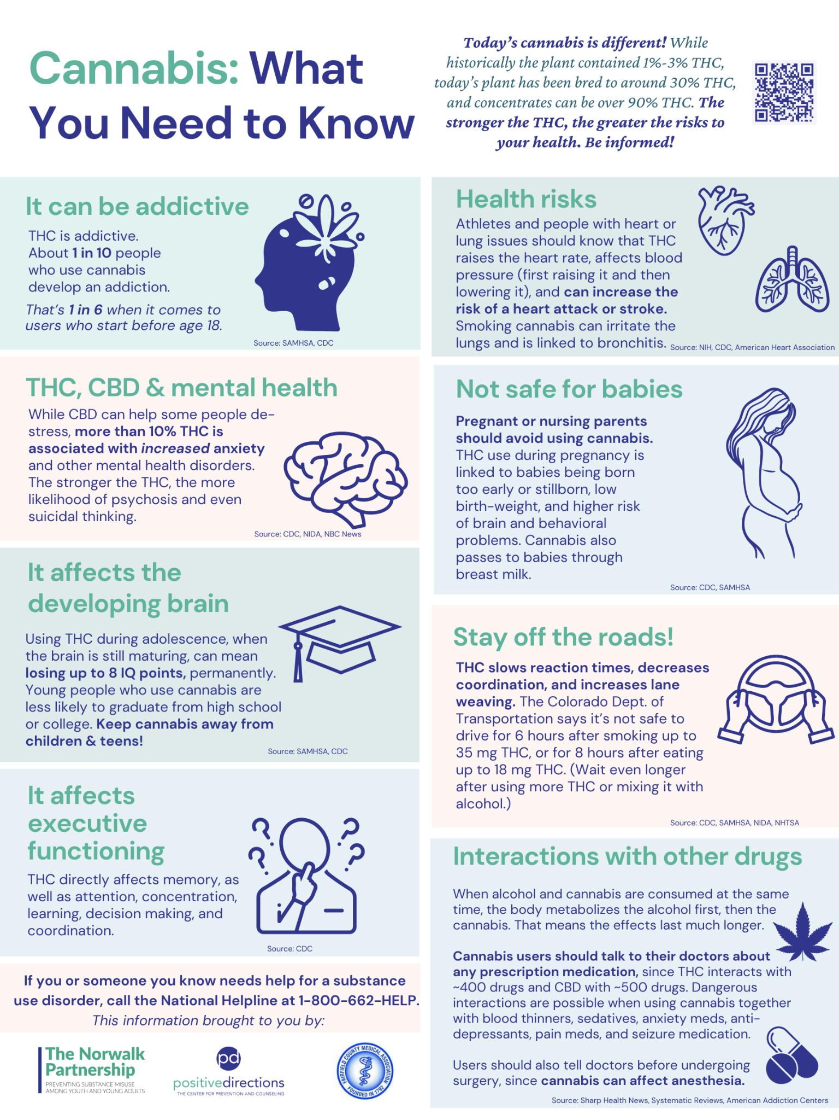
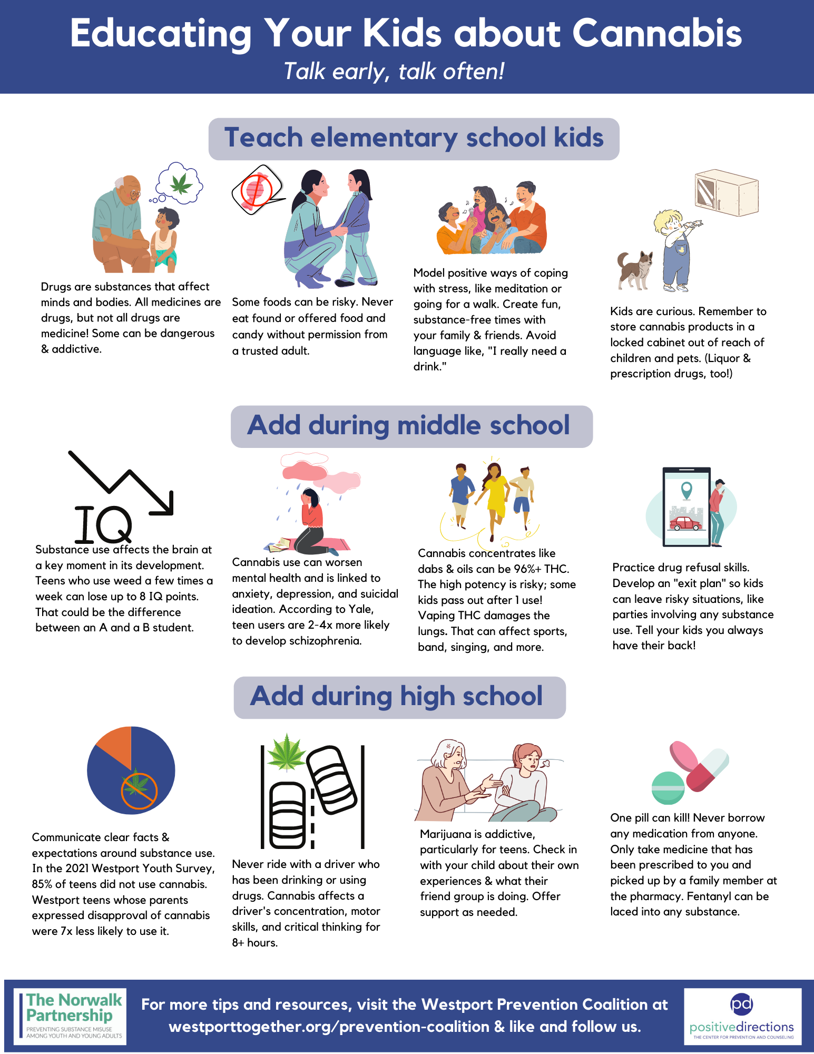
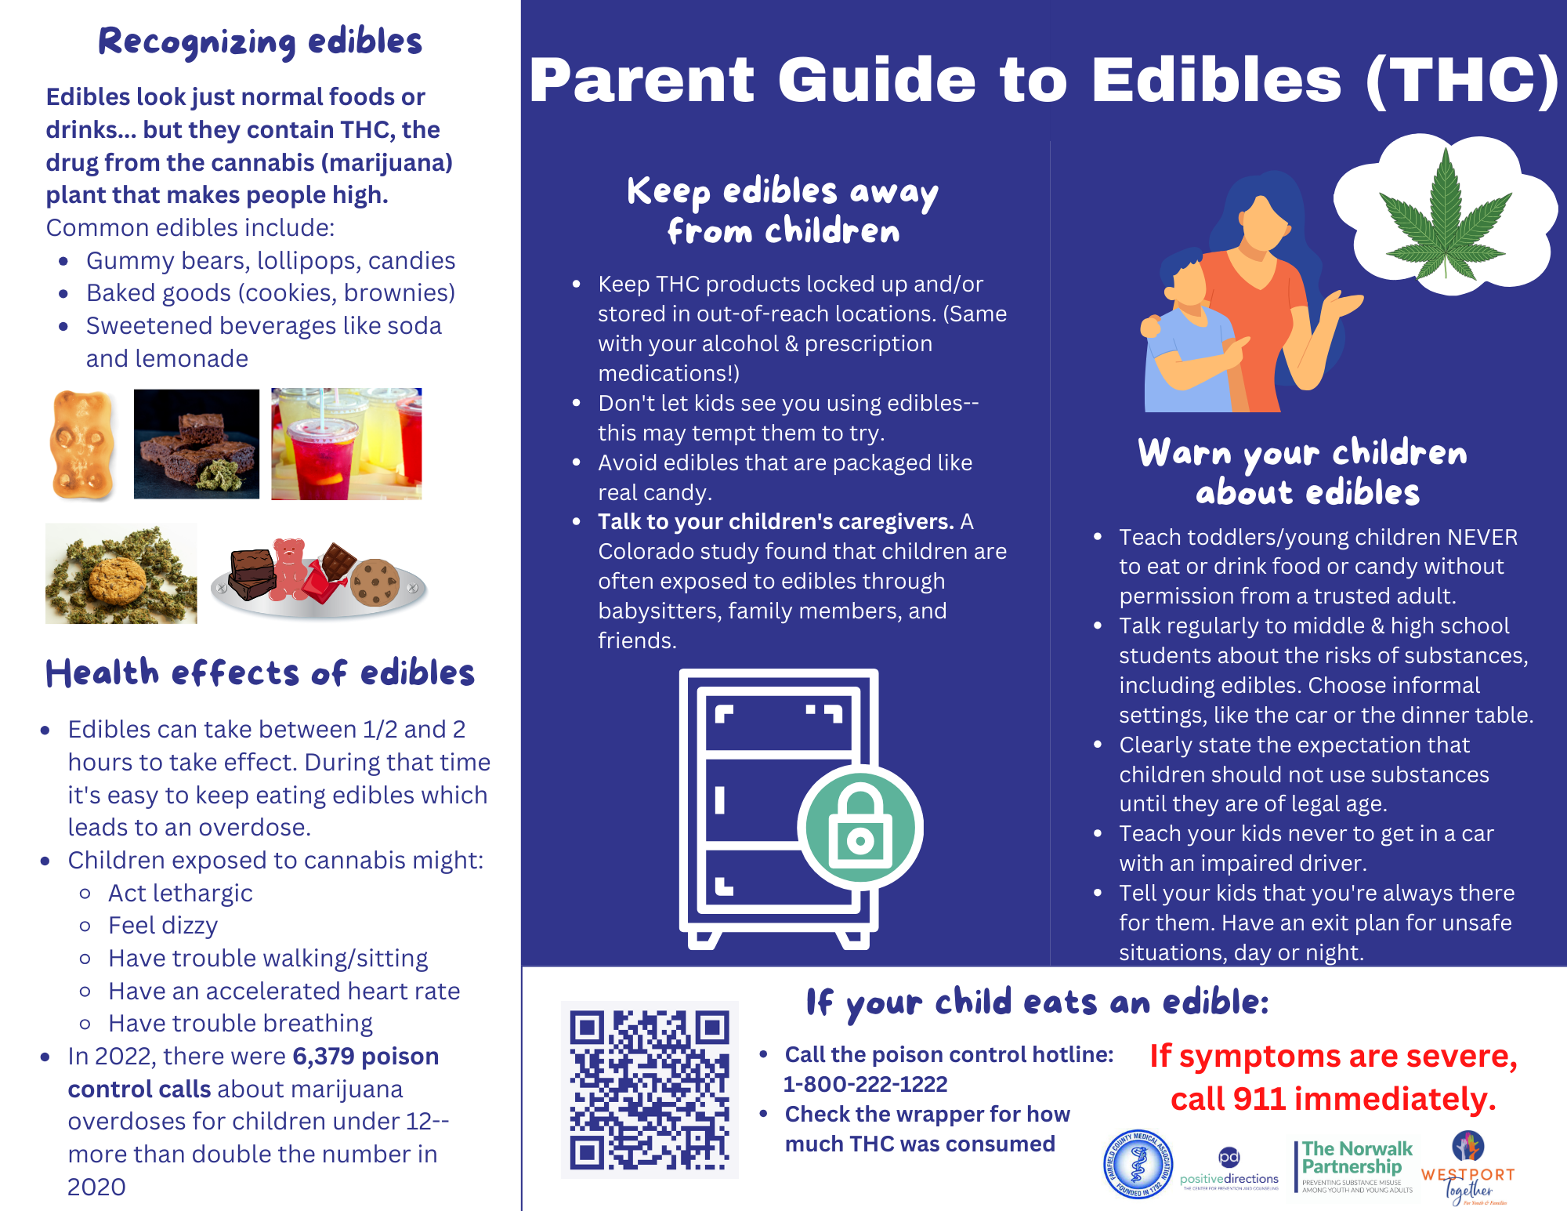
Cannabis Update
Fine Fettle
Billboard
Posters & Poison Control Cards
Notes:
Margaret 2-3 min

Slide 5
Alcohol Awareness Month
If They Had Known
Tables at HS
TTHY videos online
Agencies:
Liquor Stickers
Social Host cards
Parent Postcards
Notes:
Diamond 2-3 min to explain what we’re doing for April - more below:
If THey Had Known: Positive Directions is making this film available to stream for parents or older HS students to watch at their convenience. True story told by a college student’s friends. 35 minutes long. Link goes live on April 1st. Everyone please share it with your families!! We’ll do a blog post about it next week after April starts
Norwalk Strong clubs will have alcohol awareness month tables at both high schools during April, doing drunk goggles, how much is in a drink, etc.
TNP social media will re-run some of our 30 second “Talk.They Hear You” PSAs (from SAMHSA - the ones we had at the DMV 2 years ago) during April. Please like & reshare to your networks!!
We ask agencies to make the items listed on screen (liquor stickers, social host cards, parent postcards, etc.) available to parents during April - you can pick them up from the resource table. But you have to give the stickers directly to parents so their kids don’t get them!
Anyone doing anything else?

Slide 6
Mental Health Awareness Month / National Prevention Week
Fair update
Funding update
Lawn signs: who, where, how
Agency sign up: tinyurl.com/2024norWALKtables
Notes:
Hiba - 2-3 minutes:
33 tables so far! Can still sign up
Funding from the sources shown on the bottom of the flyer. The latest are FCA which will provide a balloon arch and Norwalk Police Dept is comping us the police officers!
Lawn signs: we ask everyone’s help in getting them out there. If you take one, be sure to take both the sign & the stake! And put your name down on the sheet showing where you’re going to put it so we don’t have duplicates. You do need to get permission from that location and be sure to put it on the building side of the sidewalk, not on the street side of the sidewalk. It cannot block traffic views. We also ask that you pick it up again after the event in May.

Slide 7
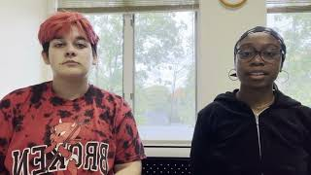
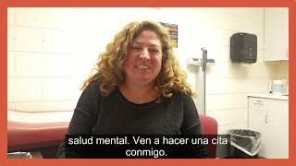
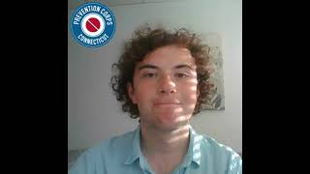
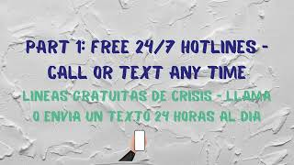
Video Project
Looking for 1 minute “the more you know”-type videos by Norwalk folks!
Volunteers for planning
Notes:
MARGARET - 2-3 min

Slide 8
Social-Emotional Health
TNP / SEH braiding
Self-Care tomorrow!
“Standard of care”: goal for all youth-serving providers
Day of Training: June 18
Notes:
AnaVivian, Shaaron - 2-3 min
Ana - explain that we braid all our substance prevention work with mental health promotion because they’re compleetely intertwined. Some of you may mostly be aware of the substance side of things, but it’s important to know that TNP’s youth survey data is planned and shared and used by the coalition, schools, and community for both SU and MH. We have intentionally braided the TNP and NACTS SEH leadership teams together so that at the planning level, we’re working together while also splitting up some of the MH and SU work.
Shaaron- invite for tomorrow. Mention that SEH is targeting youth-serving providers to have mental health/ substance prevention / LGBTQ and other critical skills to work with youth. Invite to DOT

