Slide 1
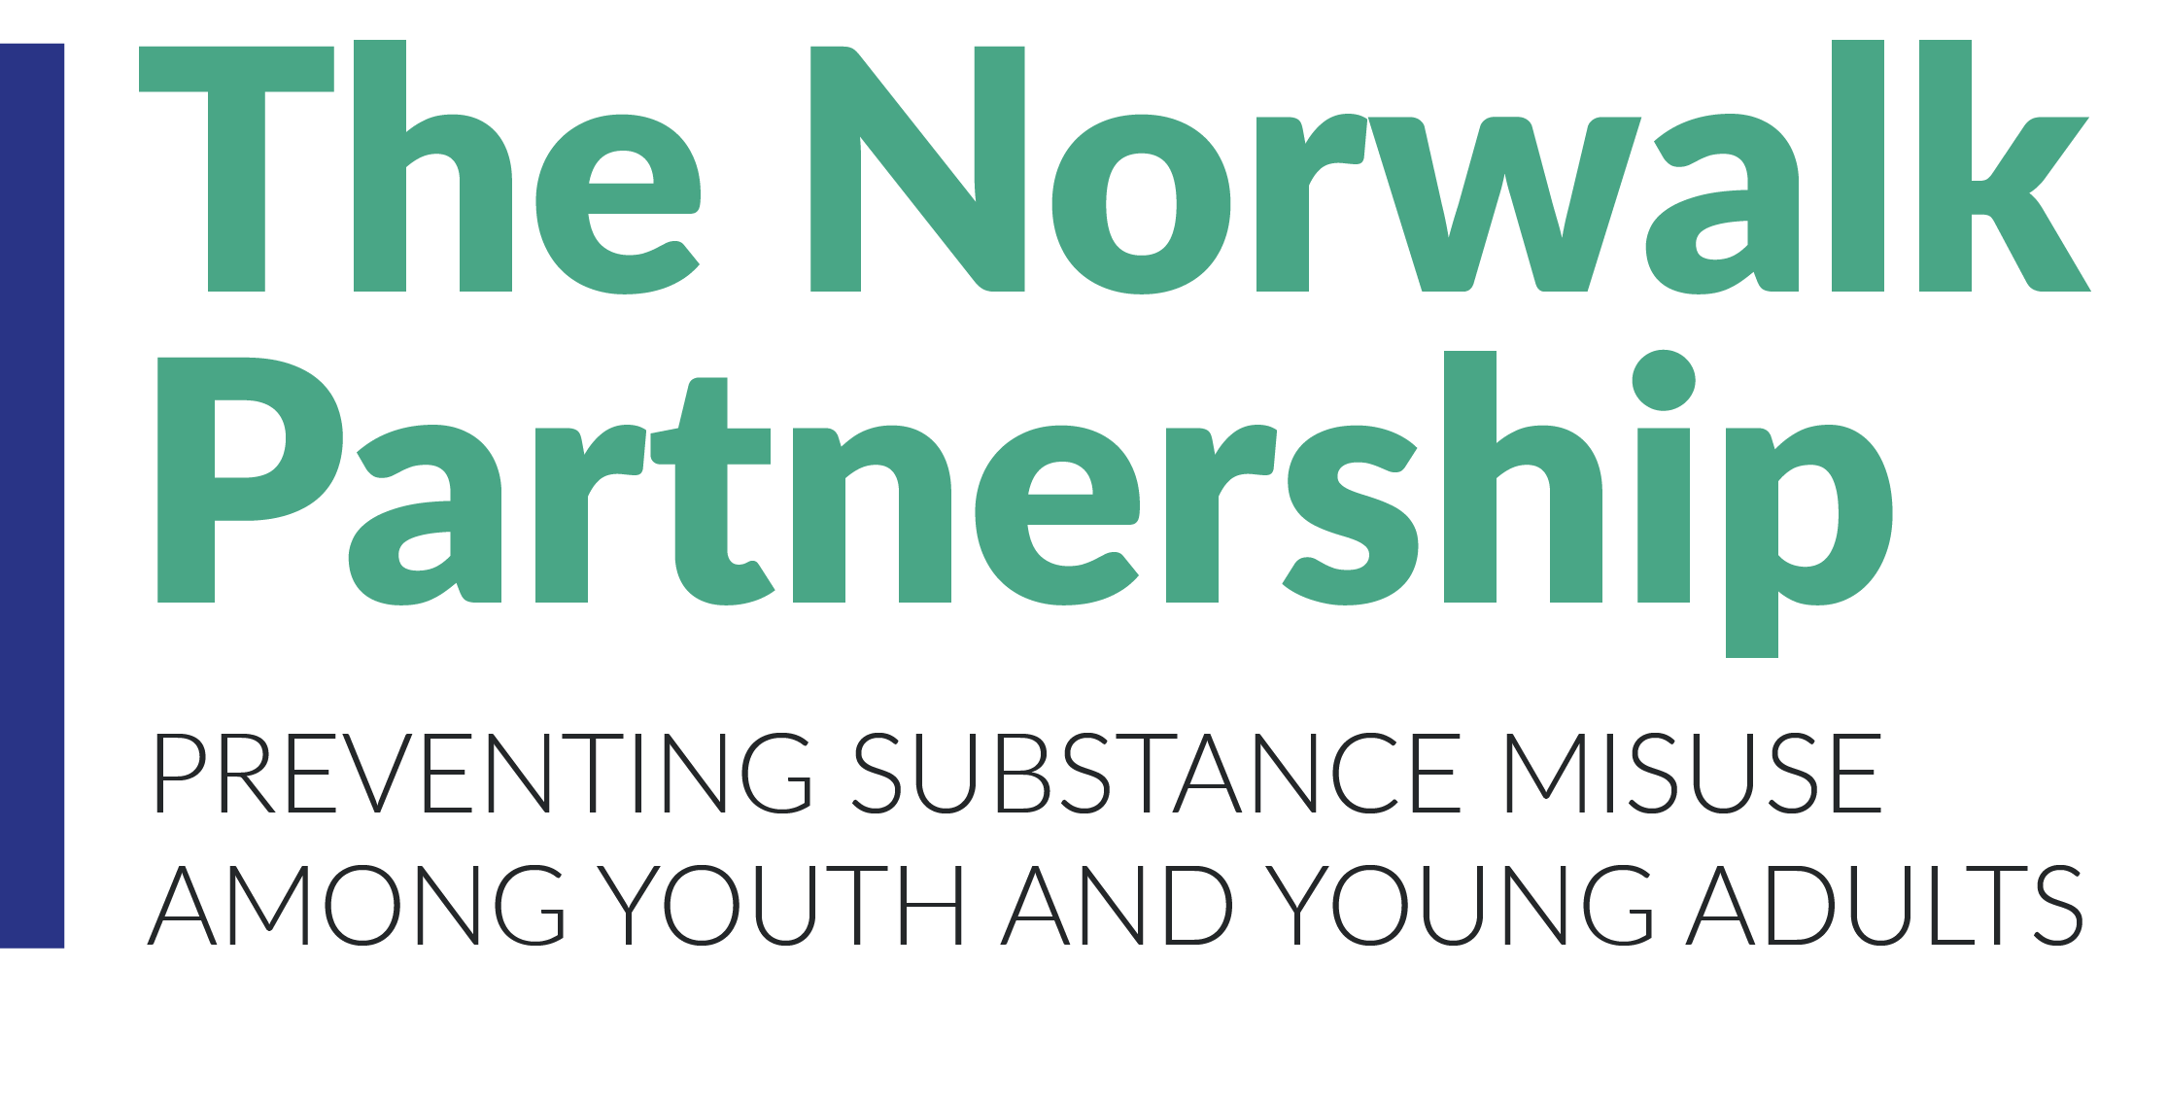
Why a Substance Use Prevention Coalition?
Notes:
Why does Norwalk need a substance use prevention coalition? And why now?

Slide 2
Relationship to community concerns
Notes:
Here’s our community, Norwalk, in the middle, and a number of likely community concerns or priorities all around. (read out) - Right now COVID is probably at the top of a lot of our lists, and education. What are some other concerns that you’d add?
As you can see, Substance Use is only one of the circles here. However, at the center of the graph, ALL the smaller circles overlap with each other. SUD impacts everything. (Give examples, and elicit examples)
Substance use: increase in day drinking reported by providers.
Increase in opioid deaths in 40 states. Drug overdoses in CT have increased 20% compared with last year. What about here in Norwalk?
SU can start young and can really mess up your life trajectory – school, jobs, etc.
Jobs are down ->depression, boredom, drinking to cope. Eve? Nicole?
Housing/homelessness: Lisa Cooper?
COVID: increased likeliness of getting sick and of being more ill when you do
Business: For the week ending May 2, total alcohol sales in the U.S. were up by more than 32% compared to the same week one year ago. https://www.yalemedicine.org/stories/alcohol-covid/ (Good for business – but access? #mentionprevention) Brian?
Public safety -> driving impaired –
Sgt Orr?
Education: Vaping in schools. Access at home for teens. Tory?
MENTAL HEALTH. Prisons.

Slide 3
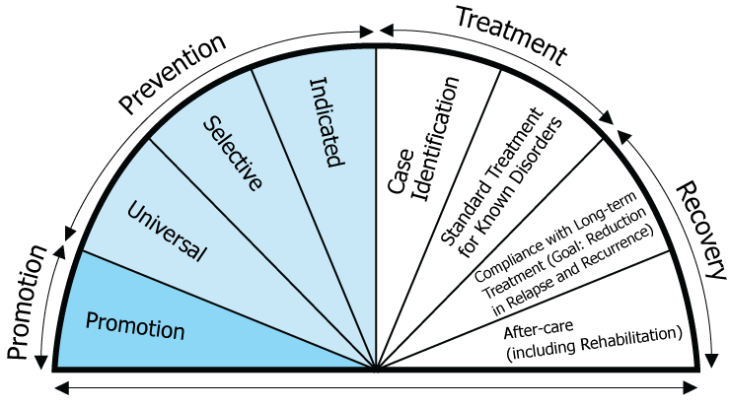
Continuum
Notes:
As we just saw, substance use can affect people’s jobs, housing, etc. – major impact on individuals and families. People who are in and out of the hospital cost healthcare and society a lot of money. People who end up homeless or in prison …
The longer we wait, the greater the impact. If we can prevent people from developing an addiction, we can avoid the trauma to them and their families, save money, create happier and healthier communities.
This graphic shows that we need a continuum of care, from general promotion of health and wellness, through prevention activities like raising awareness universally to providing selective education to target groups (like children and teens) and individuated interventions to high-risk groups… and then Tx / Recovery.
Who do you think of here in Norwalk who does health promotion?
Where are people getting their prevention education from?
Tx
Recov
Brings us to…

Slide 4
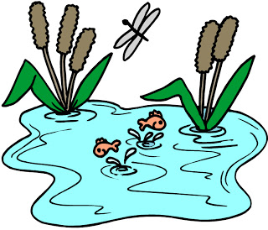
The coalition approach
Individual, Community, Environment
Notes:
Relate to mission statement - working together
Fish covered in sludge. Take it out and clean it off and put it back.
Add water purifier tablets.
Clean upstream!
Fish = youth
Water = school, home, houses of worship, extracurriculars, neighborhood
Environment = Norwalk culture, institutions, laws, enforcement
All these groups need to be around the table b/c they each have a different experience, perspective, and impact. They can each inform on what is happening, what might work, what the needs are. And there are some things that cannot be done with one group only!

Slide 5
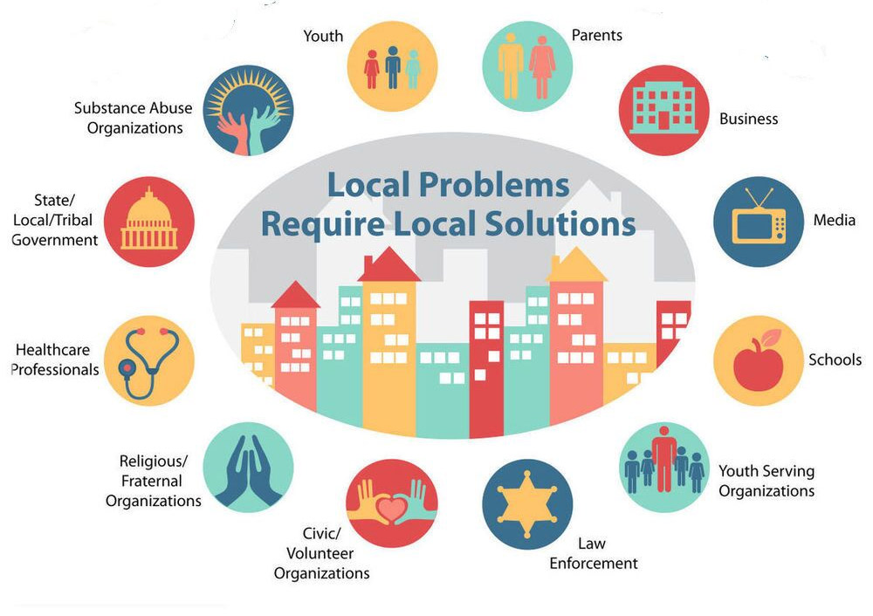
The 12 sectors of a coalition
Notes:
Plus people in recovery
Multiple people from each sector are welcome, b/c need different perspectives – also HS vs MS or ES; or
Who’s here today? Who’s not? (media)
What demographic groups could we have (muslim, southeast Asian…)
Think about who you know!

Slide 6
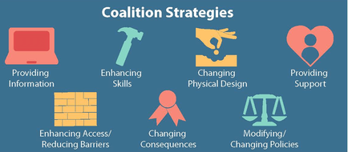
7 Strategies
Notes:
So what does a coalition do?
Individual vs environmental strategies
Let’s look at vaping. What are things that can be done using each strategy?
Which are most effective on a widespread level?
Which require the greatest effort to be implemented?

Slide 7
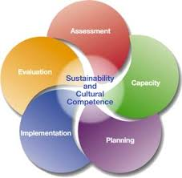
Strategic Planning Framework (SPF) model
Notes:
How do we get to this point?
(lead into DATA)

