Slide 1
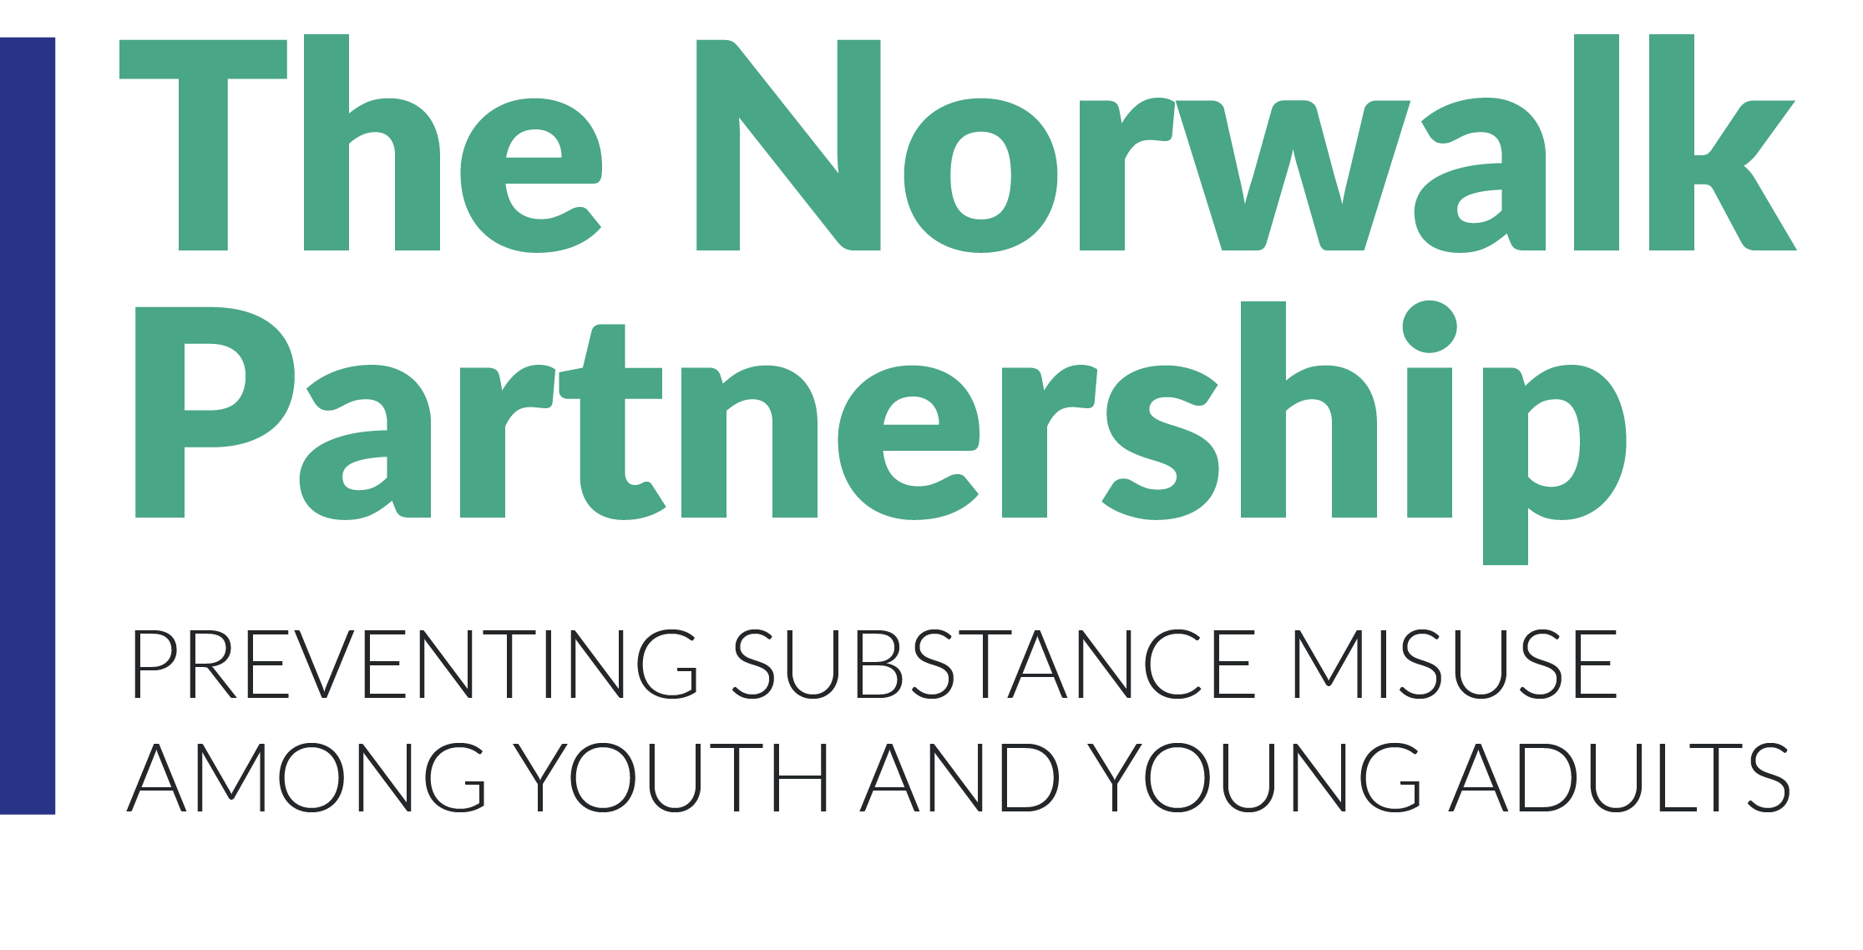
How to Plan Prevention Work
Notes:
Relate to responses: one thing you wish you could change about substance use in Westport.
Can you change it by yourself?
It all starts with a coalition to create community change. (eg, elections!)

Slide 2
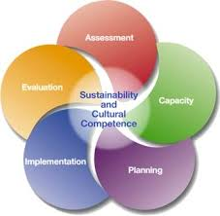
Strategic Planning Framework
Notes:
How do we get to that point?
1 strategy isn’t enough to create real change. For example, if we want to reduce or stop people from vaping marijuana, is it enough to provide support groups for people who are using it?
When a coalition is small, there’s only capacity to do a few individual programs, but not to have a comprehensive strategy. That’s why this year our LPC grant from the state includes a focus on building the coalition and its capacity so that we’ll be better positioned to do more in future. It also includes a focus on vaping.
[Westport gets just over $5000 from the state for prevention work. We tried to get the PFS grant for Westport-Weston this year but were unsuccessful. ]

Slide 3
Planning Process
Conduct Needs Assessment
Define Top Problems
Build Logic Model for Each Problem:
- Identify 2 Root Causes
- Identify 2 Local Conditions
- Develop Strategies for Each
Notes:
SPF planning & development of logic model & strategic plan the CADCA / DFC way:
Use the assessment data to pick 2 priority substances.
For each, create a problem statement in the most basic possible terms: Middle schoolers are drinking. Adults are driving drunk. Teens are binge drinking. High schoolers are using marijuana.
Build a logic model (see next slide).

Slide 4
Build Logic Model for Each Problem
Problem
Root Cause
Root Cause
Local Condition
Local Condition
Local Condition
Local Condition
S t r a t e g i e s
Notes:
SPF planning & development of logic model & strategic plan the CADCA / DFC way (cont’d):
You will end up with 2 logic models, 1 per substance.
Each starts with a problem statement in the most basic possible terms—in this case: Youth in [town] are drinking.
Then your coalition discusses the 7 root causes (see next slide) and builds consensus around the 2 root causes that are most responsible for the problem in your community.
Then, for each root cause, the coalition identifies 2 local conditions that are as specific to the community as possible. The idea is that you should be able to drive around the community and take a snapshot of the local condition.
Every item on the logic model has to have 2 associated measures that must be quantified as a baseline. Ideally one is quantitative (eg survey data) and 1 is qualitative (eg focus group), but at a minimum the 2 measures should be from different sources. So once you identify what the coalition thinks are root causes, you have to go collect data to see if those are correct – for example, do an environmental scan.

Slide 5
Define Top Problems
Notes:
SPF planning & development of logic model & strategic plan the CADCA / DFC way:
Use the assessment data to pick 2 priority substances.
For each, create a problem statement in the most basic possible terms: Middle schoolers are drinking. Adults are driving drunk. Teens are binge drinking. High schoolers are using marijuana.
Build a logic model (see next slide).

Slide 6
Identify Top 2 Root Causes
Notes:
There are 7 root causes but only 2 should be selected. The possibilities are:
Favorable community norms
Laws & enforcement
Favorable youth attitudes (perception of harm)
Favorable parental attitudes
Social availability
Retail availability
Promotion & pricing

Slide 7
Identify 2 Local Conditions per Root Cause
Notes:
There will be 2 local conditions for each root cause.
These are as specific to the community as possible.
These must be measurable in a way that is essentially VISIBLE. The idea is that you should be able to drive around the community and take a snapshot of the local condition.
Once the coalition decides what they think the conditions are (e.g., kids are vaping in the MS bathroom during lunch), you have to collect data to confirm that. Maybe the kids aren’t vaping during lunch or maybe not in the bathroom – you have to find out where and when the problem is occurring before you build out your strategies.

Slide 8
Our Alcohol Logic Model
Notes:
SPF planning & development of logic model & strategic plan the CADCA / DFC way (cont’d):
You will end up with 2 logic models, 1 per substance.
Each starts with a problem statement in the most basic possible terms—in this case: Youth in [town] are drinking.
Then your coalition discusses the 7 root causes (see next slide) and builds consensus around the 2 root causes that are most responsible for the problem in your community.
Then, for each root cause, the coalition identifies 2 local conditions that are as specific to the community as possible. The idea is that you should be able to drive around the community and take a snapshot of the local condition.
Every item on the logic model has to have 2 associated measures that must be quantified as a baseline. Ideally one is quantitative (eg survey data) and 1 is qualitative (eg focus group), but at a minimum the 2 measures should be from different sources. So once you identify what the coalition thinks are root causes, you have to go collect data to see if those are correct – for example, do an environmental scan.

Slide 9
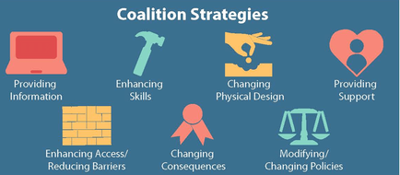
Develop Strategies for Each Local Condition
Notes:
This is where those 7 strategies come in during the planning stage.
For each of the 4 local conditions on the 2 logic models (8 local conditions total), you build out an action plan that uses all 7 strategies and several activities for each strategy. In other words, the CADCA model has 56 strategies related to your problem substances with actions related to each one. (CADCA also requires about 8 other strategies with associated actions which are all related to your Coalition Building goal.)
IMPORTANT: When building out your strategic & action plan, you start from Strategy 7 and work backwards. This way everything you do is tightly focused on your end goal. So if the policy you’re working on is to ban flavored vapes, then every strategy is also related to flavored vapes. Otherwise if you start with Strategy 1 (providing info) you can get overwhelmed with all the types of information that you could possibly provide about vaping to all kinds of audiences. This keeps you focused. Remember that you’re going to do this for 8 different local conditions so you need to keep each strategy focused!!

Slide 10
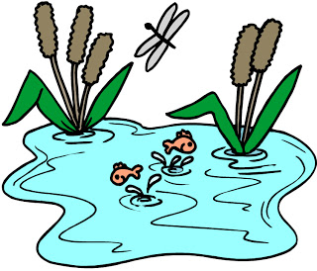
The coalition approach
Individual, Community, Environment
Notes:
Relate to mission statement - working together
Fish in a dirty pond, covered in sludge, fins can’t move, drowning. Take it out and clean its scales off and put it back.
Add water purifier tablets.
Clean upstream!
Fish = youth
Water = school, home, houses of worship, extracurriculars, neighborhood
Environment = town’s culture, institutions, laws, enforcement
All these groups need to be around the table b/c they each have a different experience, perspective, and impact. They can each inform on what is happening, what might work, what the needs are. And there are some things that cannot be done with one group only!

Slide 11
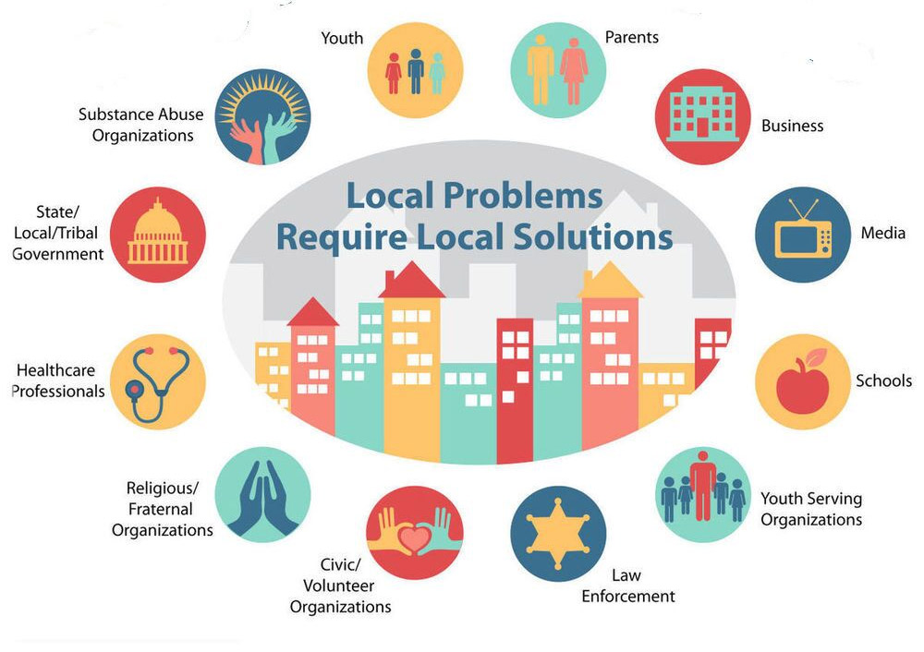
Build coalition to involve 12 sectors & all cultural groups
Notes:
Plus people in recovery
Multiple people from each sector are welcome, b/c need different perspectives – also HS vs MS or ES; or
Who’s here today? Who’s not? (media)
What demographic groups could we have (Indian…?)
Think about who you know!

Slide 12
SPF Model Ultimately Leads to Mix of 7 Strategies
Notes:
So what does a coalition do to create change? It uses the SPF model to go through a number of steps (which we’ll see in a minute) and ultimately develops a strategic plan and workplan. The strategic plan involves identifying a mix of individual & environmental strategies to address the local conditions that underlie the problem we’re trying to address.
Individual vs environmental strategies
-Which strategies are most effective for an individual person?
-Which are most effective on the community level?
Which require the greatest effort to be implemented?
Let’s look at examples of what’s been done here in town related to each strategy. Let’s use vaping as the example.
Who was providing information about vaping over the last couple of years in the community? To whom?
Who was building kids’ skills? Parents’?
Who was changing the physical design (e.g., packaging)?
Providing support (eg cessation)?
Changing access (eg smoke detectors)?
Changing consequences (citations, OSS vs ISS vs JRB referral)?
Which sectors did those things: parents? Schools? Nonprofits?
Our coalition should have those people at the table. And our coalition can work to address the areas no one else is. → PLAN
Usually individual strategies are being carried out by various groups and partners in town. These partners should all be members at the coalition table and their work should be amplified/ promoted / coordinated as appropriate, with gaps being identified. But the coalition’s main focus is the environmental strategies that require many sectors working together, because that’s what no one group (parents, schools…) can do by itself.

