Slide 1
The Norwalk Partnership
2018 Youth Survey Data
Notes:
February 2020

Slide 2
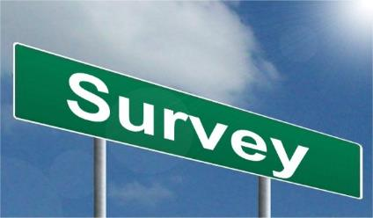
What survey did we use?
Search Institute’s Attitudes and Behaviors Survey, 160 questions
A&B Survey gives a snapshot of the current experiences and perspectives of adolescent youth in Norwalk and measures:
40 Developmental Assets, which look at external supports and internal strengths
24 youth risk behavior elements (e.g., substance use, sexual activity, antisocial behavior)
10 high-risk behavior patterns
Key social and emotional skills
8 thriving indicators (succeeds in school, helps others, values diversity, maintains good health, exhibits leadership, resists danger, delays gratification, overcomes adversity)
5 developmental deficits (alone at home, TV overexposure, physical abuse, victim of violence, drinking parties)

Slide 3
Survey Demographics
Total sample November 2018, n=1,976
Notes:
Collected in November 2018. Nathan Hale MS, Ponus Ridge MS, Roton MS, West Rocks MS, Brien McMahon HS, Norwalk HS, Center for Global Studies.
1976 surveys included in the report. 335 surveys eliminated (14% of total number). Typically see 15-25% eliminated when done on-line.

Slide 4
Reducing Risks
Many Norwalk youth are making healthy choices

Slide 5
Many Norwalk teens are not participating in risky behaviors… (but about ¼ are at risk)
7th, n=683; 9th, n=686; 11th, n=486
Notes:
The majority of Norwalk youth are making healthy and safe choices.
Teens are asked to report on whether they were involved in several risky behaviors in the past year. In 2018, reported rates around anti-social behavior (includes shoplifting, vandalism, trouble with police), gambling, violence (hitting, using a weapon, group fight, threatened harm), riding with a driver under the influence, skipping school and having sexual intercourse are in the minority.

Slide 6
…additional risky behaviors
7th, n=683; 9th, n=686; 11th, n=486
Notes:
The survey asked – “How often did you feed sad or depressed during the last month?”
21% of all students who participated in the survey reported-
All of the time 8% (n=158)
Most of the time 13% (n=257) Total = 415
The survey also asked “Have you ever tried to kill yourself?”
Yes, once (9%, n=178)
Yes, twice (2%, n=40)
Yes, more than 2x (3%, n=59)
Total – 277 students

Slide 7
Past 30-day substance use rates among Norwalk teens.
7th, n=683; 9th, n=686; 11th, n=486
Notes:
Look at 30-day use for most accurate description of what is really happening. 30-day use rates indicate that a teen has been ‘actively’ using that substance.
Alcohol has been reported to be the most frequently used substance among Norwalk youth. More youth report using alcohol than the other substances included in the survey (marijuana, cigarettes, prescription drugs, illicit drugs, heroin) – According to the CDC, people aged 12-20 drink 11% of all alcohol consumed in the US.
We realize there is one obvious substance missing from this list…vaping. In the future, this data will be included in the survey that we use. Anecdotally, we know many teens are vaping in our community couple with the fact that they have a low perception of harm around the use of this substance.
Fortunately, very few teens in Norwalk report abusing prescription drugs (3% overall) and most have a high sense of the harm associated with abuse. Continued education around this dangerous and risky behavior is critical in keeping Norwalk youth safe.

Slide 8
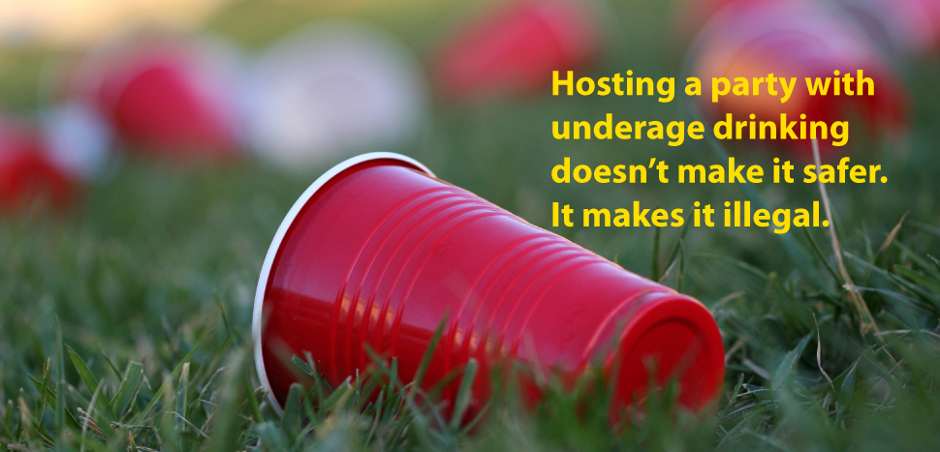
Binge drinking is reported by 40% of all 11th graders.
11th, n=486
Notes:
In addition to past 30-day use rates, the coalition pays close attention to reported binge drinking rates, which is defined on the Survey as “having 5 or more drinks in a row.” Binge drinking is a dangerous and high-risk behavior that impairs judgment and opens the door for serious consequences such as sexual assault or alcohol poisoning.
7th = 13%
9th = 26%
11th = 40%

Slide 9
National, state and local 30-day substance use rates among high school students.
Norwalk, n=1172; CT, n=2425; US, n=14,765
Notes:
Next let’s also see how we’re doing compared to teens in CT and around the country. For comparison, we use the 2019 Youth Risk Behavior Survey, the largest public health surveillance system in the United States monitoring a broad range of health-risk behaviors among high school students.
You see that reported cigarette and marijuana use rates among Norwalk high school students are all lower. Alcohol use rates are higher than state and national reported rates.

Slide 10
Perception of harm is lowest
around marijuana use.
7th, n=683; 9th, n=686; 11th, n=486
Notes:
Perceived harm associated with substance use is inversely correlated with use of that substance.
Currently, perception of harm around marijuana use is the lowest among all core substances
The Coalition keeps an eye on perception of harm reported by youth. The less harmful a teen perceives the use of a substance to be, the more likely they are to use that substance. As more states legalize marijuana for adult social use, youth increasingly believe that it must be safe for them as well. However, the introduction of a mind-altering substance, such as marijuana, to the developing adolescent brain is never safe. Ninety percent of addictions start in the teen years.

Slide 11
Perception of peer & parental disapproval impacts use rates among youth.
7th, 9th, 11th n=1976
Notes:
Norwalk teens report high levels of parent disapproval across all substances. Although parents may feel like they have little influence over their teen’s decisions, they are in fact among the most influential factors in preventing their child from using substances. Surveys of teens repeatedly show that parents can make an enormous difference.
Norwalk youth who DO NOT believe their parents disapprove of them drinking alcohol are more likely to drink. Similar findings around peer disapproval – the more a peer disapproves of use, the less likely they are to use (or start using) a substance.

Slide 12
Youth who believe their parents disapprove of substance use are less likely to use than those who do not.
30-day alcohol & marijuana use rates:
Notes:
Overall, high perception of parent disapproval among Southington teens.
A young person’s perception of their parent’s disapproval is correlated to a young person’s choice to use substances. If teens perceive their parents believe it is wrong for them to drink or use substances, when faced with the opportunity, they are less likely to do so.
When looking at students who feel their parents disapprove of use overall 30-day use rates are much lower compared to students who believe their parents don’t really think drinking or smoking marijuana is wrong (or only a little bit wrong.) The data clearly illustrates that students who believe that their parents think it is wrong to use substances are less likely to drink or smoke marijuana.
10x more likely to use marijuana and 4x more likely to drink alcohol

Slide 13
Substance use rates by gender & race
30-day use & GENDER | All (n=1976) % | Male (n=900) % | Female (n=938) %
Alcohol | 25.5 | 24.3 | 24.6
Alcohol-Binge | 13.0 | 13.0 | 12.0
Marijuana | 11.0 | 11.3 | 9.8
Tobacco | 1.6 | 1.9 | 1.0
Rx Drugs | 2.9 | 2.7 | 2.9
30-day use & RACE/ETHNICITY | All (n=1976) % | Hispanic/ Latino (n=935) % | White (n=732) % | Black (n=357) % | Multi-racial (n=159) % | Asian (n=100) %
Alcohol | 25.5 | 24.8 | 30.2 | 22.1 | 25.8 | 11.0
Alcohol-Binge | 13.0 | 13.6 | 13.8 | 14.1 | 15.4 | 5.0
Marijuana | 11.0 | 12.0 | 11.3 | 15.1 | 8.1 | 3.0
Tobacco | 1.6 | 1.8 | 1.6 | 2.8 | 1.3 | 1.0
Rx Drugs | 2.9 | 3.6 | 2.9 | 5.9 | 5.0 | 0.0

Slide 14
Substance use rates by MH, sexuality
30-day use & mental health indicators | All (n=1976) % | Sad or Depressed (n=395) % | Attempted Suicide (n=274) % | Eating Disorder (n=401) %
Alcohol | 25.5 | 34.4 | 36.1 | 30.4
Alcohol - Binge | 13.0 | 17.7 | 20.1 | 20.2
Marijuana | 11.0 | 16.8 | 17.6 | 16.9
Tobacco | 1.6 | 2.5 | 4.3 | 3.4
Rx Drugs | 2.9 | 6.5 | 10.8 | 7.0
30-day use & sexual orientation | All (n=1976) % | Bisexual, Mostly or Only Gay/Lesbian (n=143) %
Alcohol | 25.5 | 34.0
Alcohol-Binge | 13.0 | 17.0
Marijuana | 11.0 | 17.0

Slide 15
Substance use and other risky behaviors
30-day use & risky behaviors | All (n=1976) % | Ditched School (n=282) % | Hit (n=498) % | Stealing (n=376) % | Vandalism (n=157) %
Alcohol | 25.5 | 37.5 | 35.0 | 46.8 | 58.0
Alcohol - Binge | 13.0 | 24.6 | 21.9 | 28.6 | 43.5
Marijuana | 11.0 | 24.4 | 19.4 | 27.5 | 30.0
Tobacco | 1.6 | 4.2 | 3.4 | 5.2 | 10.7
Rx Drugs | 2.9 | 5.7 | 6.8 | 9.2 | 13.4

Slide 16
Focus Groups
Stress
On a scale of 1 to 5, groups averaged 2.8 and 3.2 = moderate stress
Youth with higher stress indicated it is due to:
Family members at risk of COVID
Sports
College
Coping
Sports with friends
Virtual meets – texting, movie nights,
Video games (increase in this)
Working
Socializing
Friend group size while socializing was varied, groups of 2 to 15
Youth indicated they were socializing in all locations - Outside, Inside, On-line
“Outdoor- but not always following social distancing rules.”
Socializing less, the same or more?
Majority of youth said less or the same
Notes:
October 19th we did 2 virtual focus groups at Brien McMahon HS – during Health class.
All juniors and seniors. 22 students in total.
Focus was on stress, coping, socializing and substance use.
I am going to share some of the highlights with you now.

Slide 17
Focus Groups – October 2020 Substance Use - Alcohol
Majority said use has remained the same or increased
1 teen felt that alcohol use was happening more among adults versus teens as a way to cope with what was going on
Her classmates “are doing things they shouldn’t be because they have nothing better to do and a lot of them have stress and stuff also.”
Ease of Access
Majority of youth felt it was Easy to get access to alcohol
2 students who indicated it would be hard stated that they would never take it from their home.
Where is access from?
Older siblings/friends (3)
Parents' stash/homes (4)
Stores (3)

Slide 18
Substance Use - Marijuana
Majority said use has increased
One male was not sure if increase was due to increased stress or being inside
Another male thought increase was because of free time among peers.
Ease of Access
Majority of youth felt it was Easy to get access to marijuana
“overly easy”
One female stated that she could “get it from 5 different people right now if I wanted to get it.”
Where is access from?
Social media – Snapchat
Plugs
School
Friends
Parents – one female said she know about parents who give their child permission to use marijuana

Slide 19
Substance Use - Vaping
Majority said use has decreased (10); remained the same (4)
“the hype around vaping has gone down; only people with nicotine addiction still do that” (most in group agreed)
One female said her friends have switched to vapes because they don’t have the money for marijuana
Ease of Access
Majority of youth felt it was Easy to get access to vapes
“too easy”
Where is access from?
Stores (some places don’t card)
Gas stations (not checking IDs) “my friend can just go buy at a gas station and is not carded”
Students selling to students (in school too)
Friends

Slide 20
Focus Group Survey
Most of my friends… | Very true % | Somewhat true % | Not true % | Don’t know %
believe that marijuana is less dangerous than alcohol or pills. | 32 | 36 | 32 | 0
believe that marijuana helps them drive better. | 9 | 27 | 64 | 0
say their parents advise them to avoid drugs other than alcohol and weed. | 41 | 46 | 14 | 0
My friends’ parents
Allow them to use weed at home | 5 | 14 | 55 | 27
Use marijuana at home | 0 | 14 | 46 | 41

Slide 21
Focus Group Survey - Access to substances.
 | Alcohol # | Marijuana # | Vapes #
Their own house | 12 | 10 | 15
Someone else’s house | 13 | 10 | 13
A car | 9 | 9 | 13
A parking lot or garage | 7 | 8 | 10
At a park | 9 | 9 | 11
At a beach | 9 | 5 | 11
At school | 4 | 7 | 16
My friends don’t drink/use weed/vape | 5 | 7 | 6

Slide 22
Next steps
Collect more focus group data
Norwalk High School
Norwalk Middle Schools
Parent Survey
November 2020
Youth Survey
Winter 2021

